Slide 1


Video Google
An overview of:
A Text Retrieval Approach to Object Matching in Videos
Lorenzo Andrés Vigo del Rosso • Computer Vision
MSc Fundamental Principles of Data Science

Slide 2
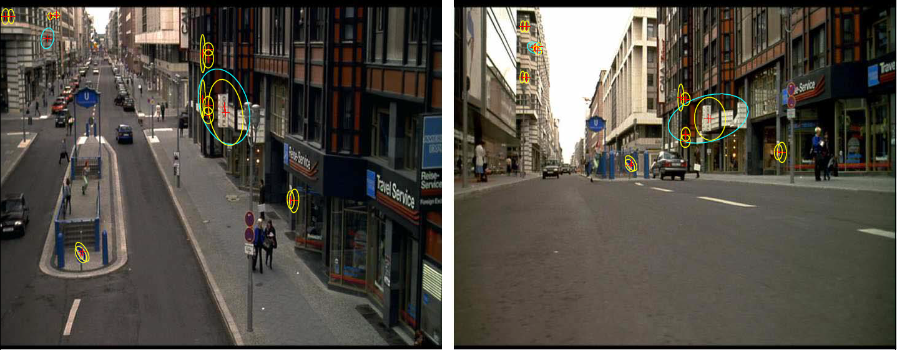
Video Google
Object Matching in Videos
Content
2 •
Notes:
Variations viewpoint, illumination, occlusion => big obstacles. Some solutions already

Slide 3
Video Google
Object Matching in Videos
ACCURACY
SPEED
3 •

Slide 4
Video Google
Not owned by Google by any means.
Great speed in retrieval of results.
Results presented in a ranked list.
4 •

Slide 5
Video Google
Text retrieval in Google
A wet brown dog came running and did not bark, lifting a wet feather of a tail. The man followed in a wet black oilskin jacket, like a chauffeur, and face flushed a little. She felt him recoil in his quick walk, when he saw her. She stood up in the handbreadth of dryness under the rustic porch. He saluted without speaking, coming slowly near. She began to withdraw.
5 •

Slide 6
Video Google
Text retrieval in Google
A wet brown dog come running and did not bark, lifting a wet feather of a tail. The man followed in a wet black oilskin jacket, like a chauffeur, and face flushed a little. She feel him recoil in his quick walk, when he see her. She stand up in the handbreadth of dryness under the rustic porch. He saluted without speaking, comeng slowly near. She begin to withdraw.
6 •

Slide 7
Video Google
Text retrieval in Google
A wet brown dog come running and did not bark, lifting a wet feather of a tail. The man followed in a wet black oilskin jacket, like a chauffeur, and face flushed a little. She feel him recoil in his quick walk, when he see her. She stand up in the handbreadth of dryness under the rustic porch. He saluted without speaking, comeng slowly near. She begin to withdraw.
7 •

Slide 8
Video Google
Text retrieval in Google
wet 3
come 2
bark 1
black 1
brown 1
chauffeur 1
dog 1
feather 1
follow 1
jacket 1
lift 1
man 1
oilskin 1
run 1
tail 1
8 •
Notes:
Actually weighted: tf-idf

Slide 9
Video Google
Text retrieval in Google
Inverted File Index:
wet doc1 (3), doc3 (2), doc10 (2)
come doc1 (2), doc2 (1)
bark doc1 (1), doc2 (4)
black doc1 (1), doc5 (7)
brown doc1 (1), doc12 (3)
chauffeur doc1 (1), doc4 (1)
dog doc1 (1), doc9 (12)
feather doc1 (1)
follow doc1 (1), doc6 (1)
jacket doc1 (1), doc7 (2)
lift doc1 (1), doc11 (1)
9 •

Slide 10
Video Google
From text to video
corpus
documents
words
video
frames
objects / features
10 •

Slide 11
Video Google
Video Google
object/feature1 3
object/feature2 2
1
1
1 1
1
… 1
1
1
1
1
1
1
object/featureN 1
Vector of occurences
of a frame:
11 •

Slide 12
Video Google
Video Google
Inverted File Index:
object/feature1 frame1 (3), frame3 (2), frame10 (2)
object/feature2 frame1 (2), frame2 (1)
frame1 (1), frame2 (4)
frame1 (1), frame5 (7)
frame1 (1), frame12 (3)
… frame1 (1), frame4 (1)
frame1 (1), frame9 (12)
frame1 (1)
frame1 (1), frame6 (1)
frame1 (1), frame7 (2)
object/featureN frame1 (1), frame11 (1)
12 •

Slide 13
Video Google
From text to video
corpus
documents
words
video
frames
objects / features
13 •

Slide 14
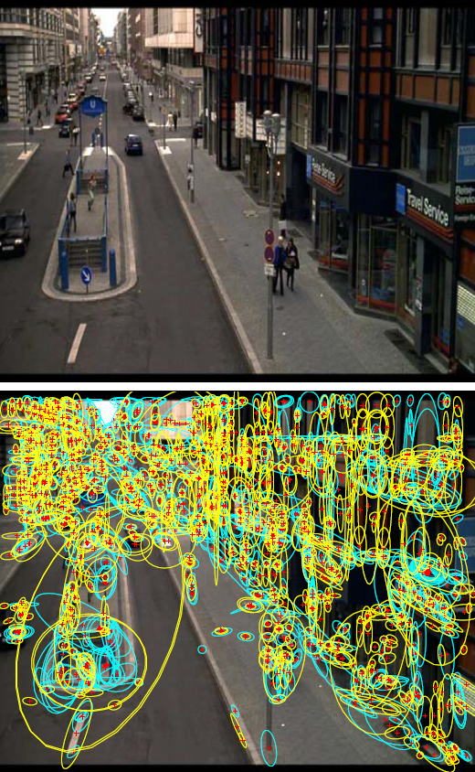
Video Google
Feature and Object representation
Shape Adapted regions (SA): elliptical adaptation of points of interest. Focus on corner-like features.
Maximally Stable regions (MS): areas approximately stable as the intesity threshold changes. Focus on high contrast zones.
14 •
Notes:
SA:
Scale determined by local extermum of a Laplacian
Shape maximizing intenisty gradient over the region.
MS:
constructed by selecting areas from an intensitity watershed image segmentation.

Slide 15
Video Google
Feature and Object representation
SA and MS are computed as viewpoint invariant regions
+
Use of SIFT descriptors to describe the regions
=
Description vectors invariant to affine transformations
15 •
Notes:
SA:
Scale determined by local extermum of a Laplacian
Shape maximizing intenisty gradient over the region.
MS:
constructed by selecting areas from an intensitity watershed image segmentation.

Slide 16
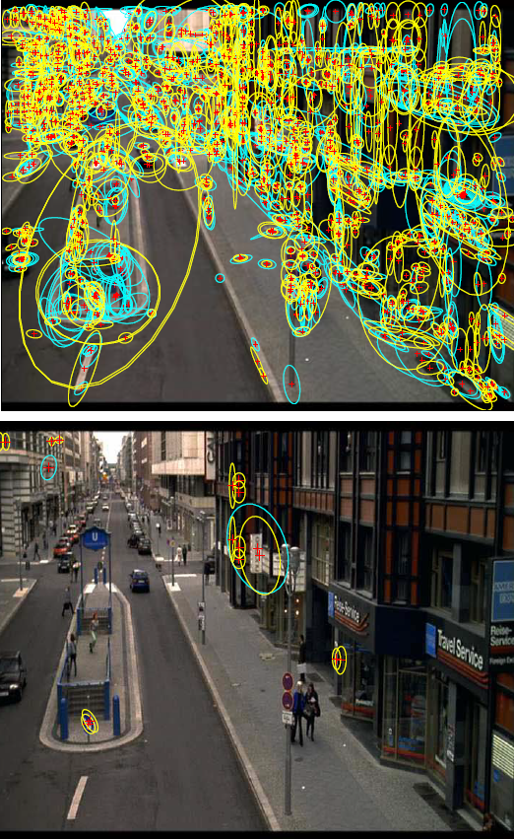
Video Google
Feature and Object representation
Get rid of unstable and noisy regions by information aggregation over a sequence of frames.
Constant velocity dynamical model.
16 •
Notes:
SA:
Scale determined by local extermum of a Laplacian
Shape maximizing intenisty gradient over the region.
MS:
constructed by selecting areas from an intensitity watershed image segmentation.

Slide 17
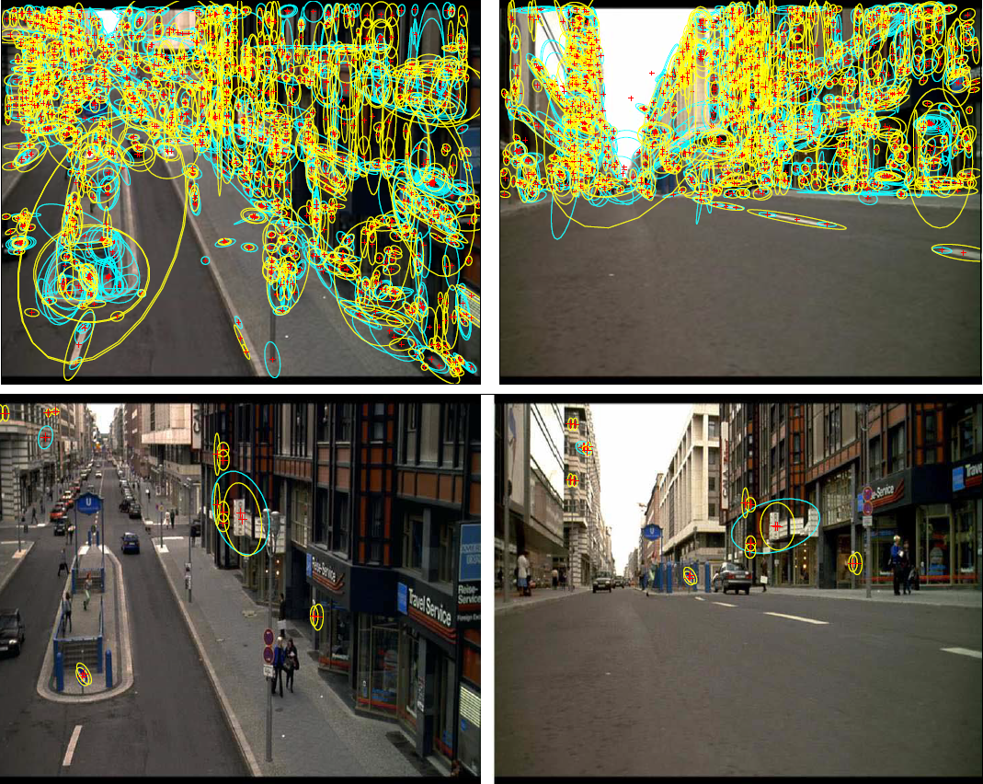
Video Google
17 •

Slide 18
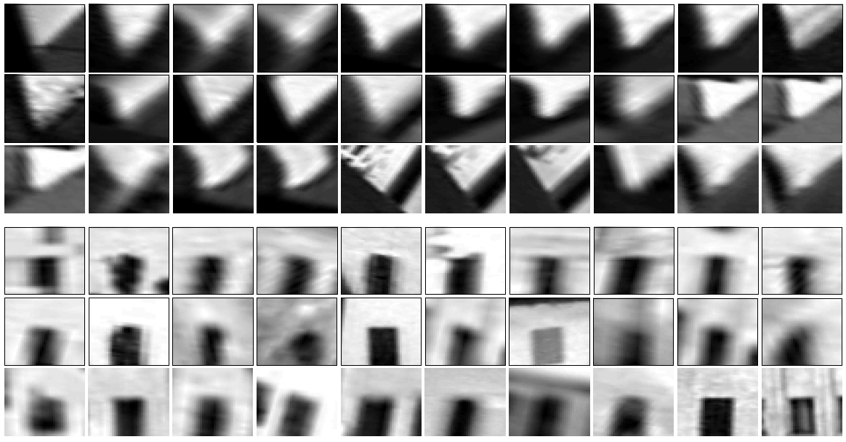
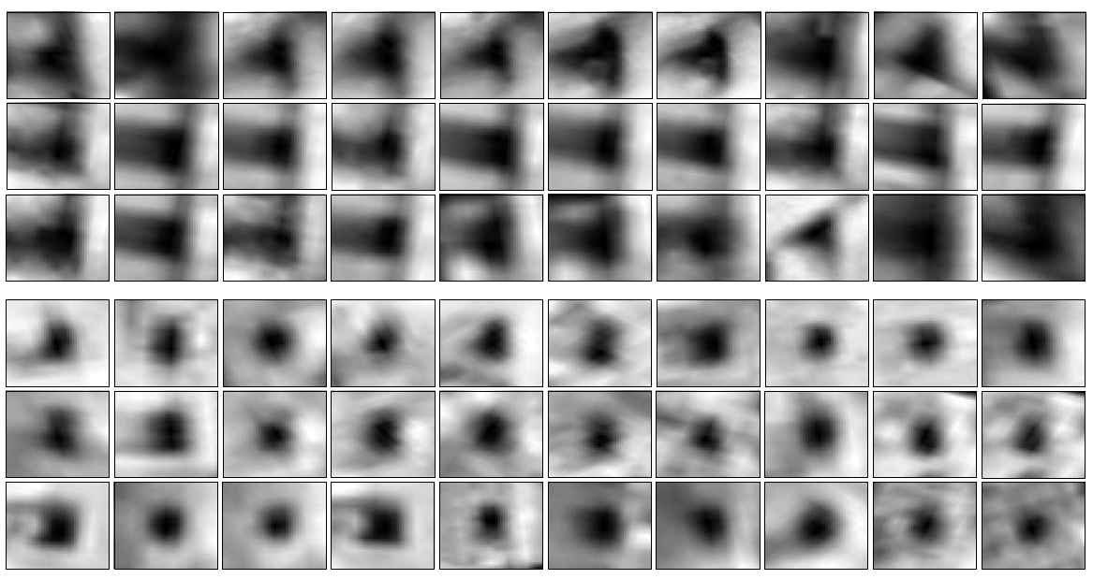
Video Google
K-Means Clustering
18 •
Notes:
Mahalanobis distance

Slide 19
Video Google
Video Google : K-Means Clustering
cluster1 3
cluster2 2
1
1
1 1
1
… 1
1
1
1
1
1
1
clusterN 1
Vector of occurences
of a frame:
19 •

Slide 20
Video Google
Video Google: K-Means Clustering
Inverted File Index:
cluster1 frame1 (3), frame3 (2), frame10 (2)
cluster2 frame1 (2), frame2 (1)
frame1 (1), frame2 (4)
frame1 (1), frame5 (7)
frame1 (1), frame12 (3)
… frame1 (1), frame4 (1)
frame1 (1), frame9 (12)
frame1 (1)
frame1 (1), frame6 (1)
frame1 (1), frame7 (2)
clusterN frame1 (1), frame11 (1)
20 •

Slide 21
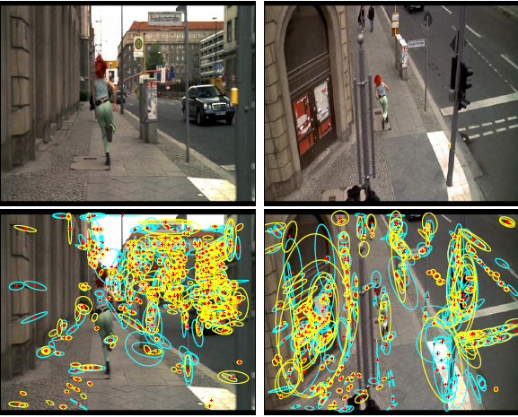
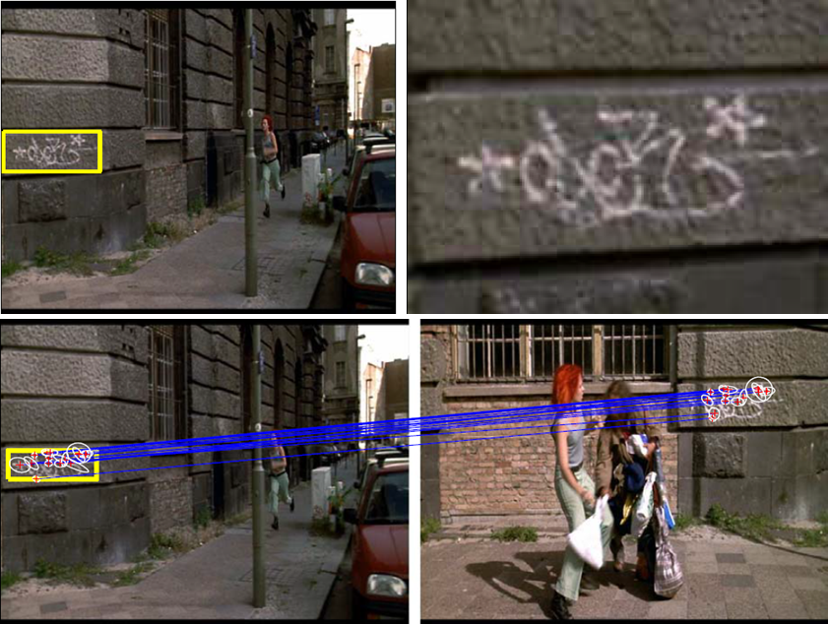
Video Google
Scene Matching
Content
21 •

Slide 22
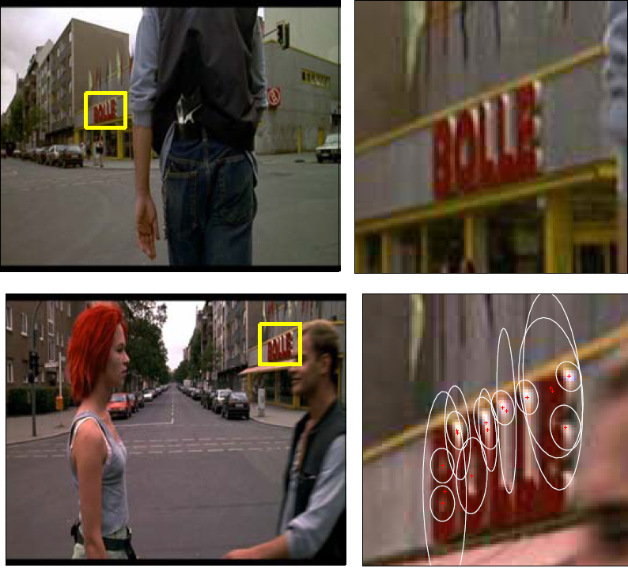
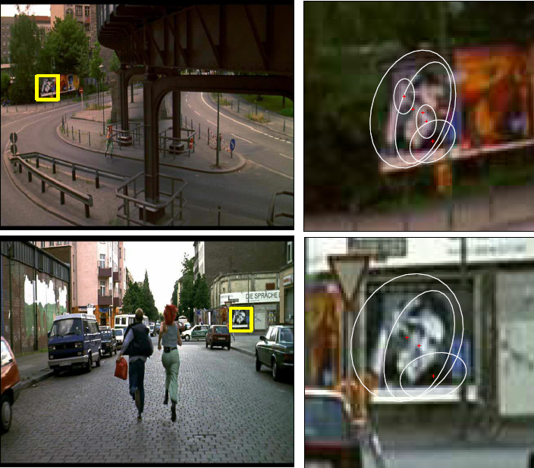
Video Google
Object Retrieval
22 •

Slide 23
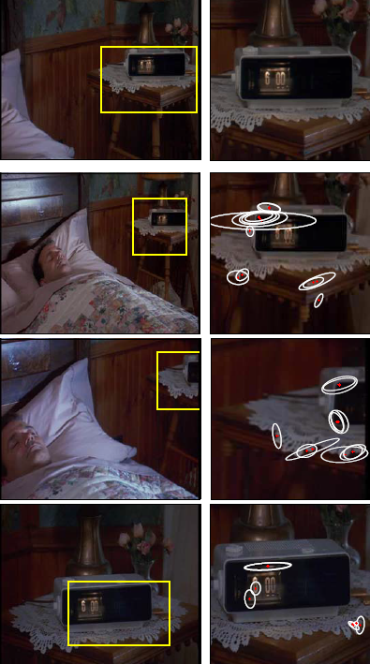
Video Google
Limitations
Dimensionality
Textures
Low rankings
23 •

Slide 24
Video Google
An overview of:
A Text Retrieval Approach to Object Matching in Videos
Lorenzo Andrés Vigo del Rosso • Computer Vision
MSc Fundamental Principles of Data Science

Slide 25

Video Google
Title
Content
# •

Slide 26
Video Google
Title
Content
# •

Slide 27
Video Google
Title
Content
# •

